Slide 1
Website image creation

Slide 2
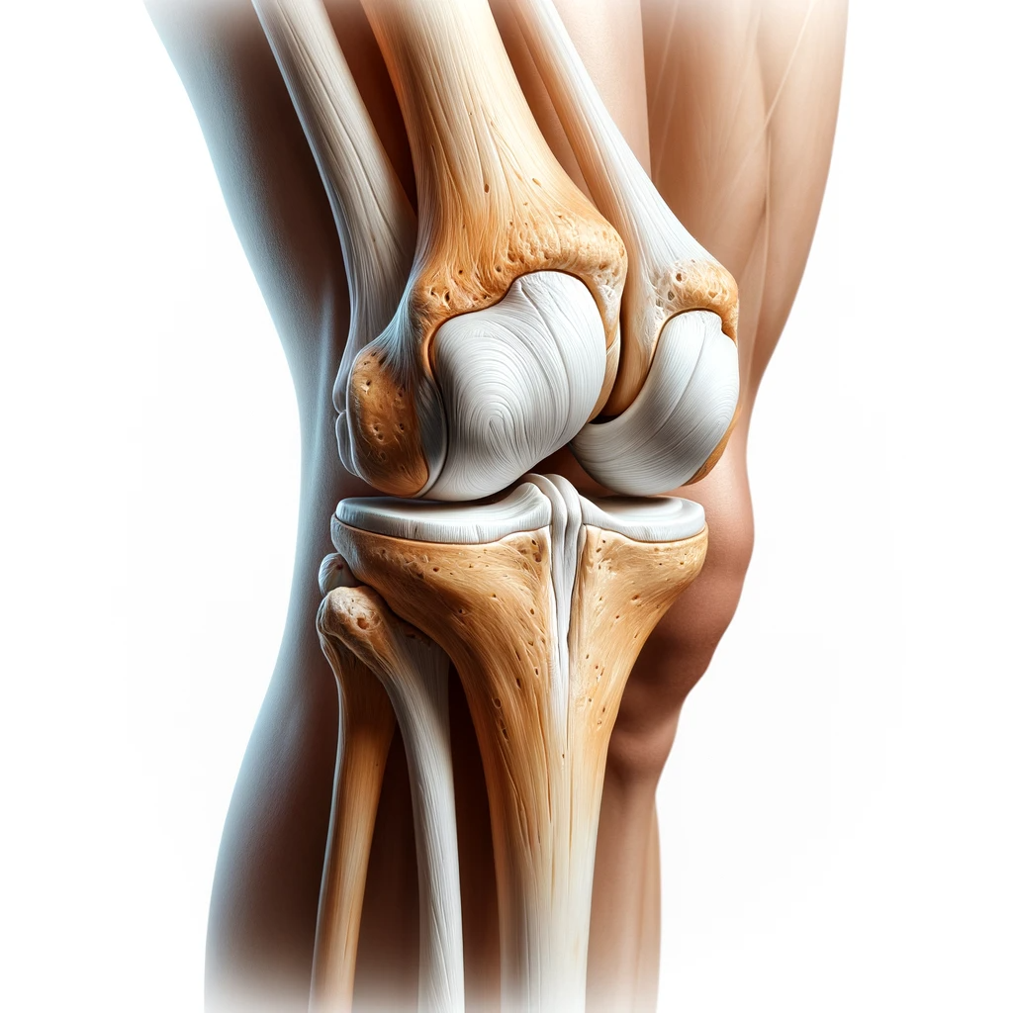
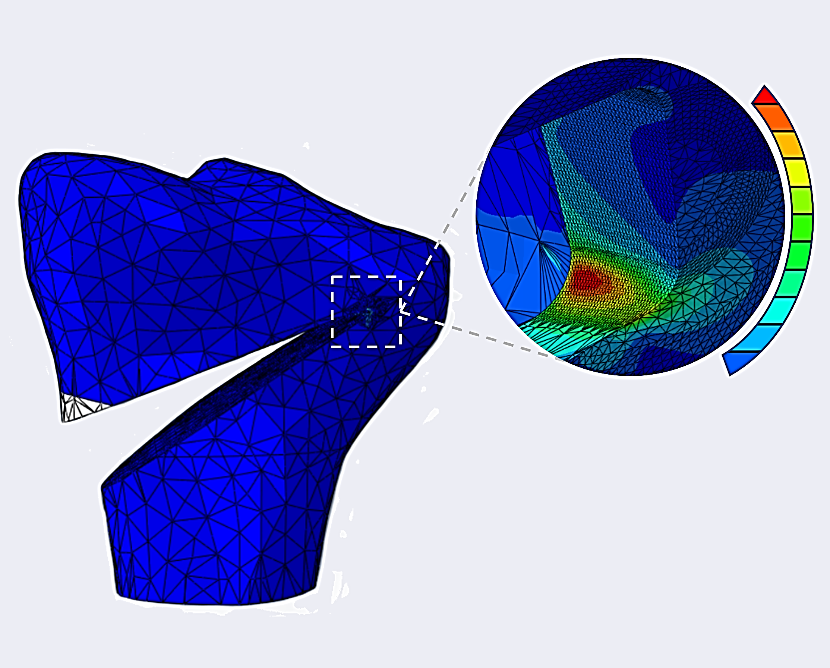

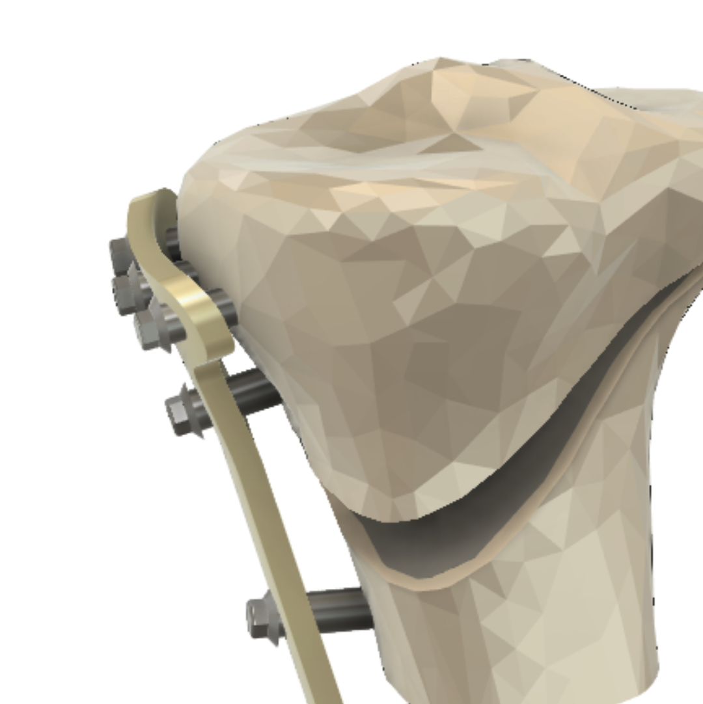
STRESS
SURGICAL
CUT
FIXATION PLATE
PROXIMAL TIBIA
FINITE ELEMENT ANALYSIS

Slide 3
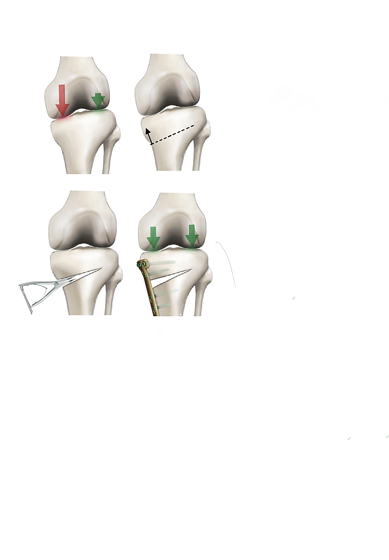

Slide 4
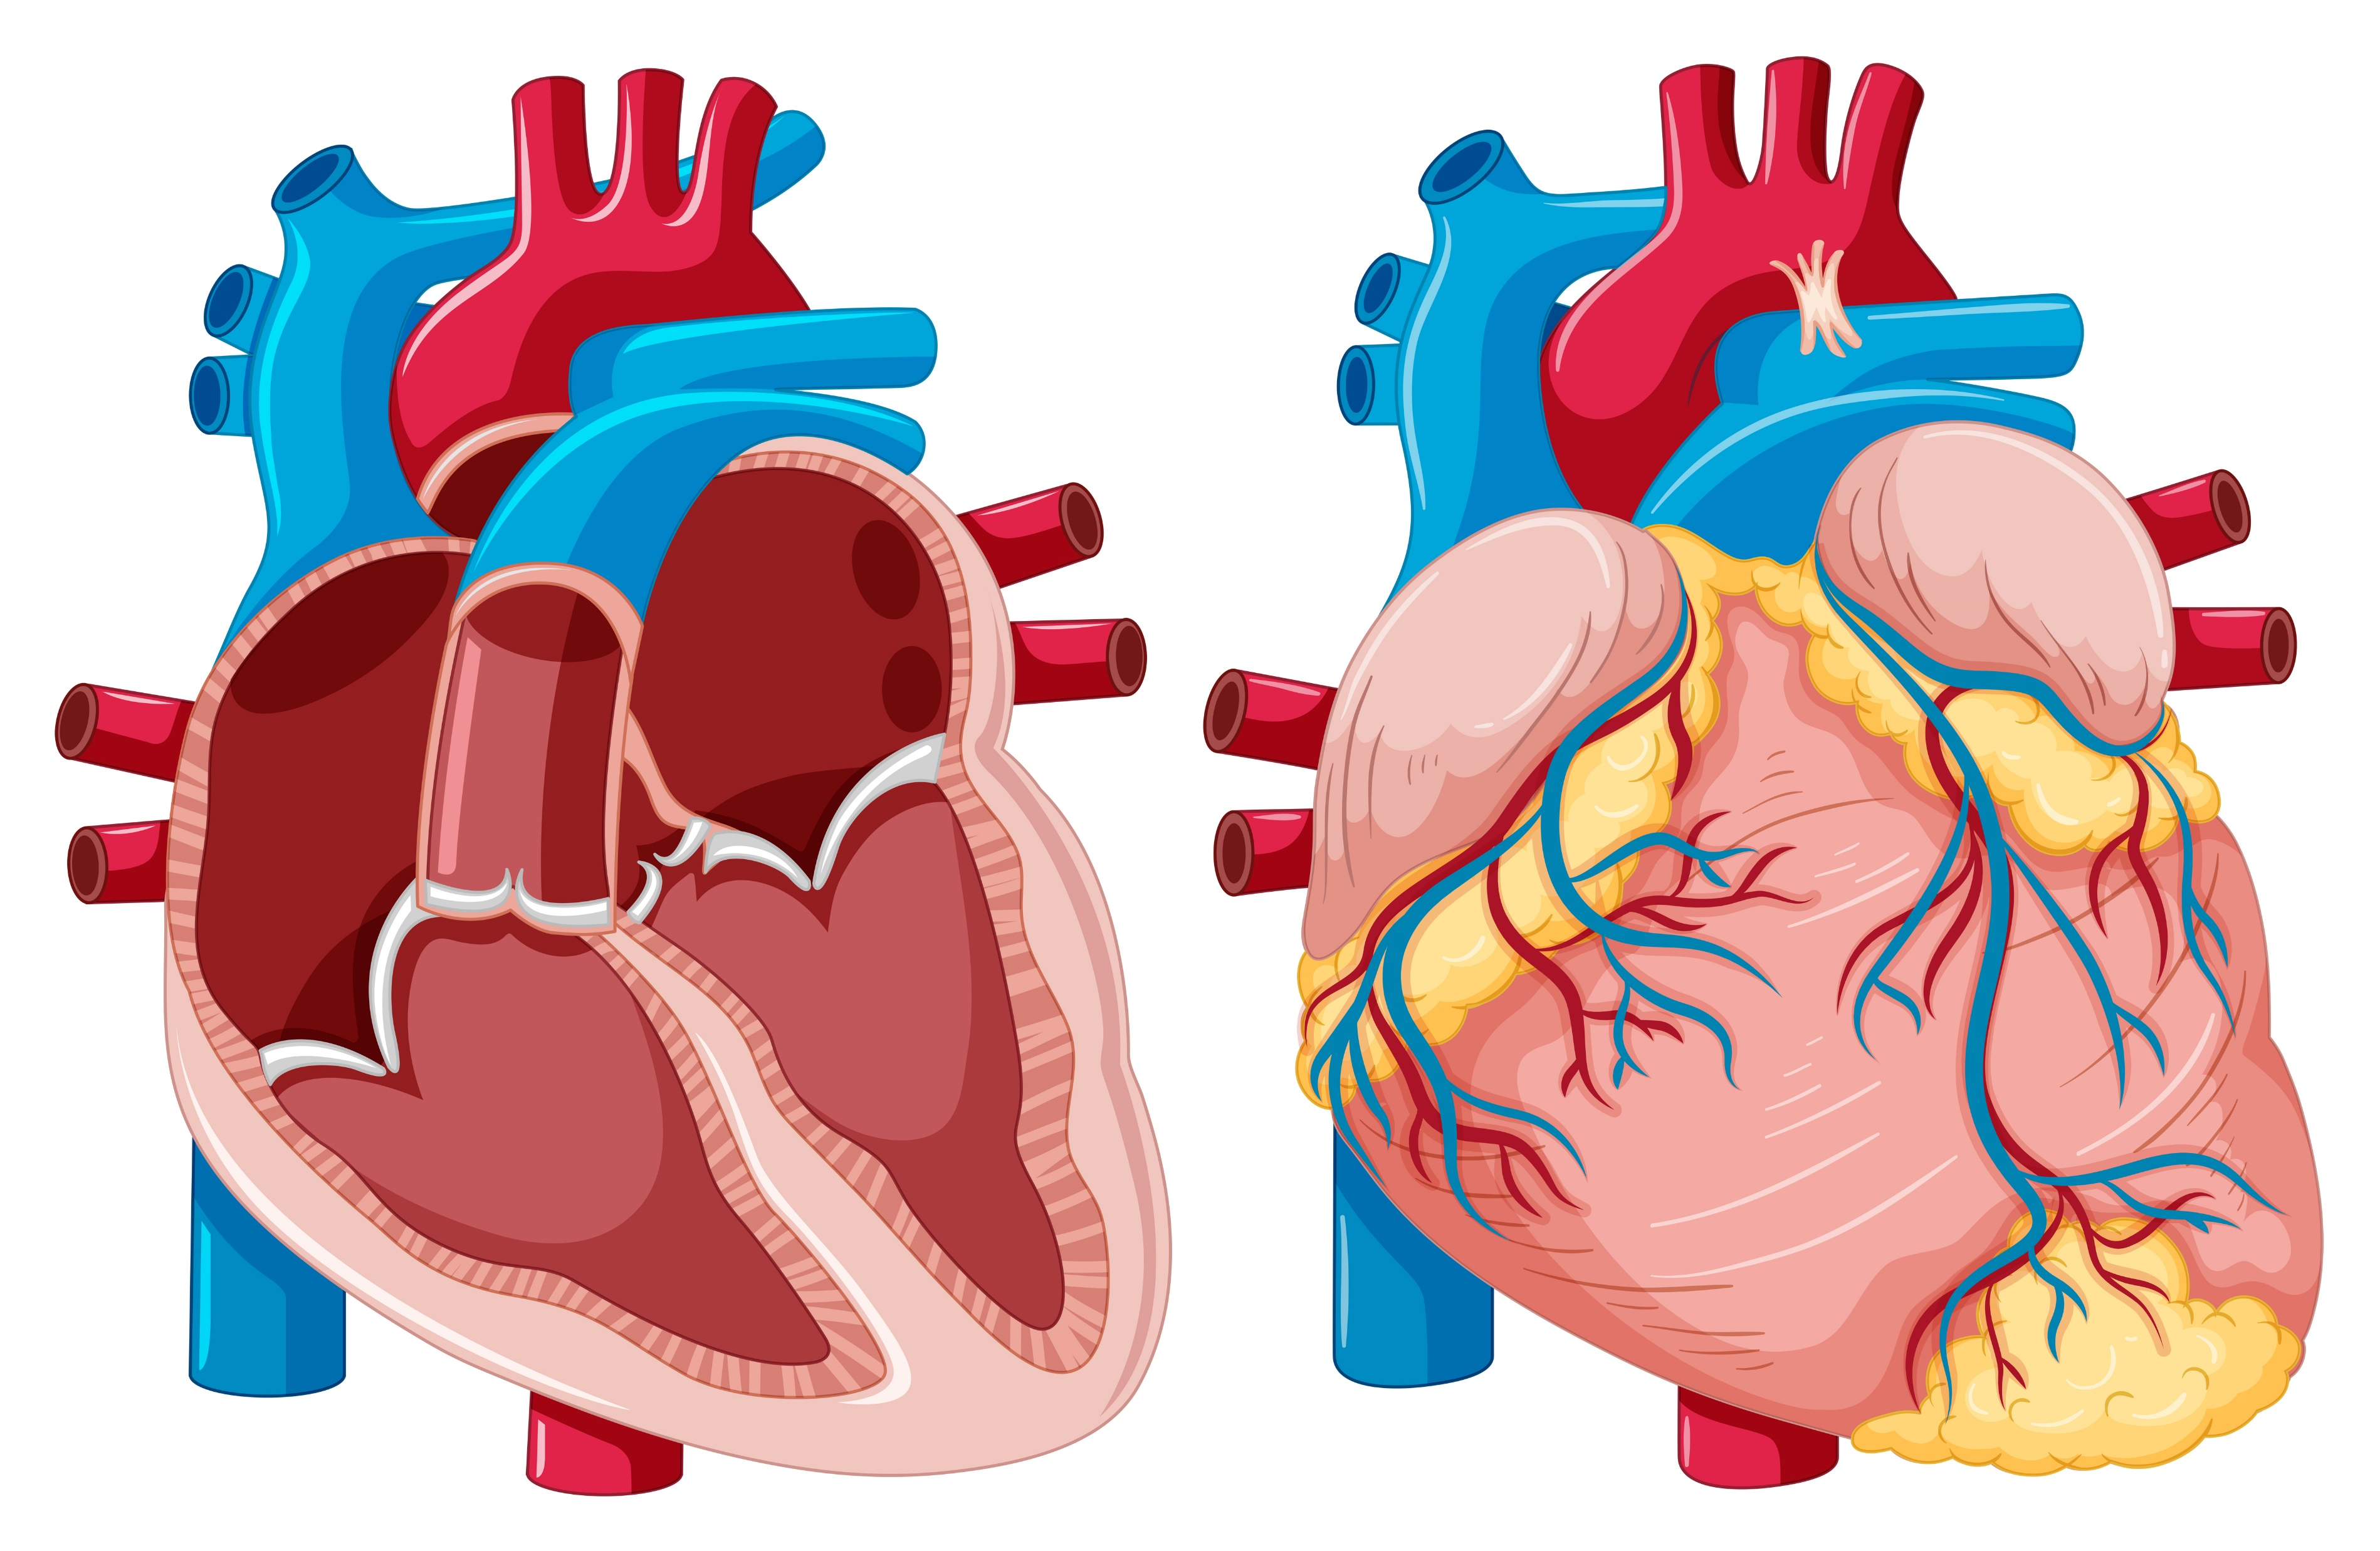
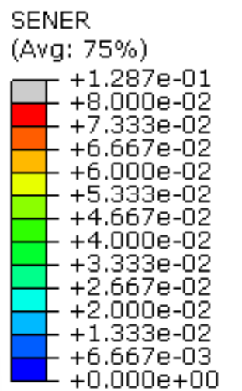
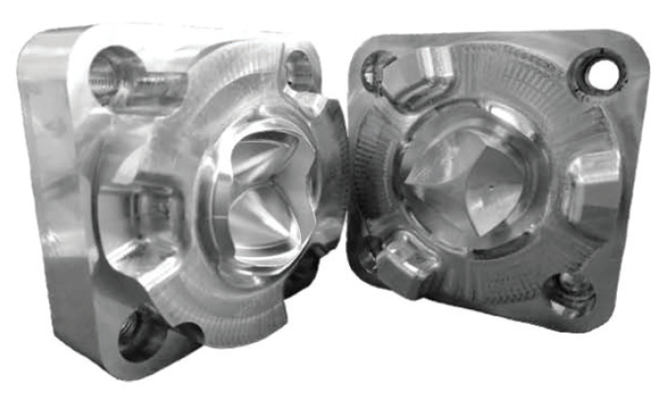
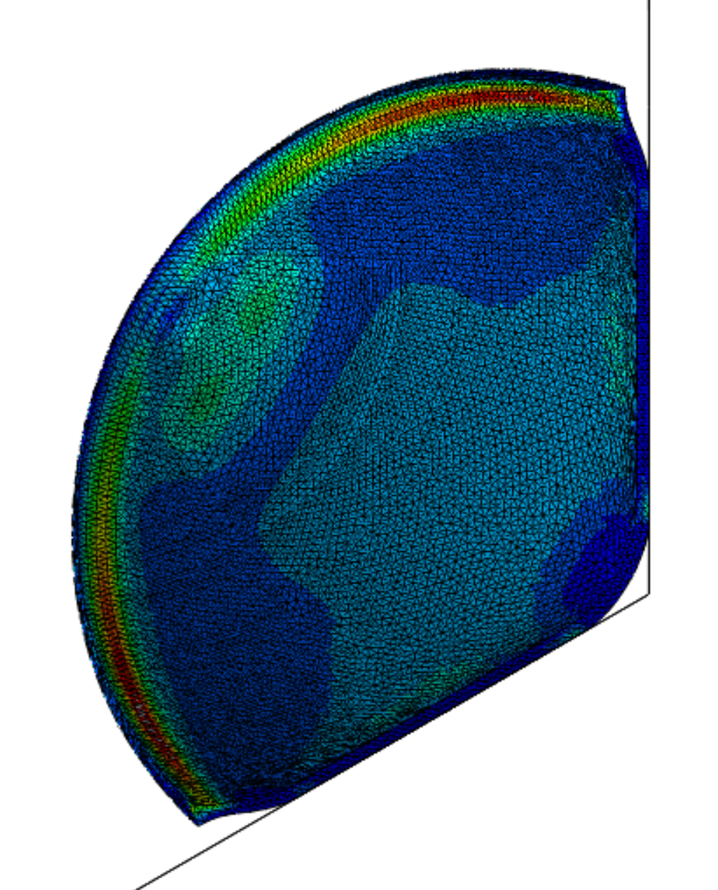
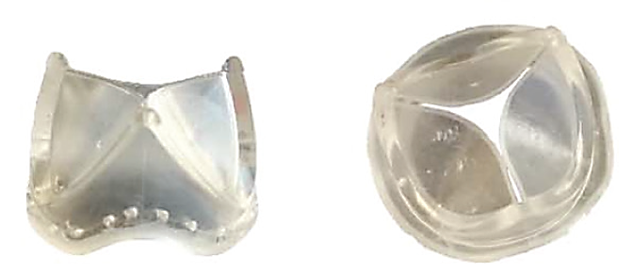
INJECTION MOULDS
STRESS
NATIVE
AORTIC VALVE
POLYMER VALVE
PROSTHESIS
VALVE LEAFLET FEA

Slide 5
